Slide 2
Azure’s Cloud Platform: Building serverless applications
Eldert Grootenboer
Cloud Solution Architect
Microsoft Azure MVP

Slide 3
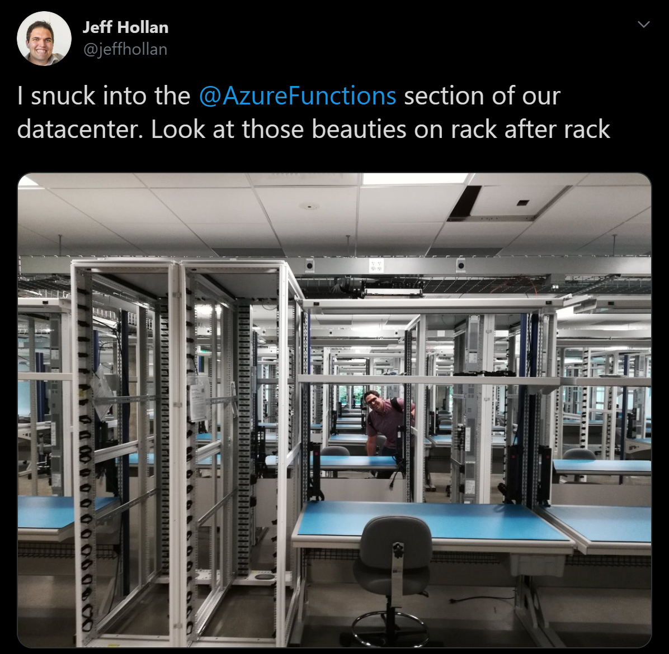
What is “Serverless”
Abstraction of servers
Event-driven scale
Sub-second billing
Notes:
3

Slide 4













Demo – Onboarding Process
Notes:
https://eldertnet.sharepoint.com/sites/BuildingServerlessApplications/Lists/Onboarding/AllItems.aspx
eldert@eldert.net – Organizational account
Go over each serverless component as wrap up

Slide 5





Better Together

Slide 6



Thank You!
@egrootenboer
eldert@eldert.net
https://www.linkedin.com/in/eldert-grootenboer

